Slide 2
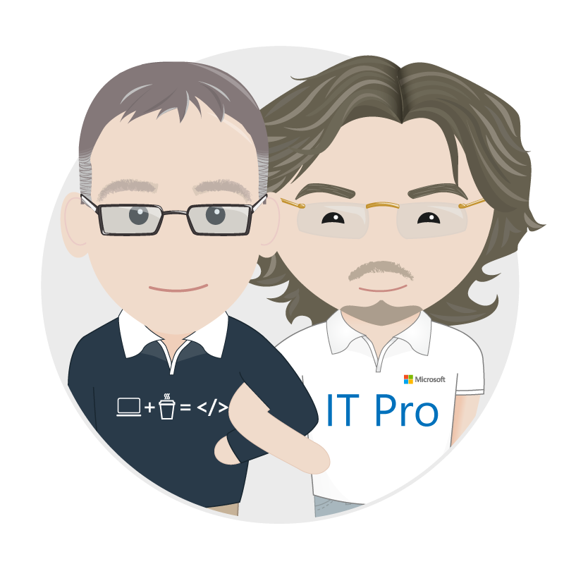


Living the dream – Real world devops with Azure and VSTS
Richard Fennell
Engineering Director, Black Marble
MVP (Visual Studio and Developer Tools)
ALM Ranger
Rik Hepworth
IT Director, Black Marble
MVP (Azure)
@rikhepworth
@richardfennell

Slide 3




Agenda: Walking through the process
Develop
Build
Deploy to QA
Deploy to Lab

Slide 4
Demo
DevOps Walkthrough

Slide 5
Summary
DevOps is a process not a technology solution
Your steps may differ
No one tool will solve everything
Configuration as code is a key enabler for automation
Essential for cloud; useful for on-prem

Slide 6
Useful Links:
Black Marble VSTS Extensions in Marketplace: http://bit.ly/VSTSBM
Our Githubs: https://github.com/rikhepworth/
https://github.com/rfennell
Our blogs: http://blogs.blackmarble.co.uk

Slide 7







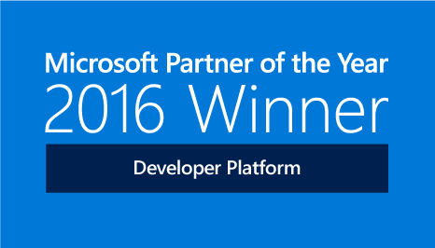

blogs.blackmarble.co.uk
+44 (0)1274 300175
@blackmarble
Black Marble Ltd.
Black Marble
Thanks for listening
@rikhepworth
@richardfennell

